Slide 1
www.escardio.org
©2023 European Society of Cardiology. May not be reproduced, displayed, modified or distributed without explicit written permission from ESC.

Slide 2


Our Mission
To reduce the burden of
cardiovascular disease
©2023 European Society of Cardiology. May not be reproduced, displayed, modified or distributed without explicit written permission from ESC.

Slide 3
Innovation, Agility
and Creativity
• Adapt quickly and creatively to
emerging needs and evolving trends
• Be ready to experiment, learn from
failure, and improve
Integrity
• Be trustworthy through rational, enlightened, and transparent decisions
• Adhere to strong principles and the transparency of motivation, processes, and leadership
• Doing what we say we will do
• Be responsible for our Society, the cardiovascular community, and the environment
Our Values
Values are an essential component of strategy.
They define the way in which the organisation wants to achieve its aims.
Inclusivity, Respect and Empathy
• Acknowledge and include all stakeholders in cardiovascular medicine
• Welcome and nurture an open and diverse community that is attractive to all
• Cultivate a strong sense of team spirit that drives the Society
The Pursuit of Excellence
• Focus on our mission
• Always keep the patient front of mind
• Leverage our expertise to provide the best possible answers for cardiovascular health
• Maintain and enhance the professionalisation of ESC activities
The European Society of Cardiology
is driven by the following values:
©2023 European Society of Cardiology. May not be reproduced, displayed, modified or distributed without explicit written permission from ESC.

Slide 4






Trends
Cardiology as a Medical Specialty / Community
Cardiology & Cardiovascular Medicine
Education & Training
Subspecialisation & super-specialisation
Cardiology as an interdisciplinary community
Decreasing Euro-centricity of the global medical community
Co-creation / patient involvement
Dynamic & implementable guidelines
Cardiovascular medicine increasingly requires competence beyond cardiology, such as data science, engineering
Shortage of volunteers as a quality resource for ESC
Shrinkage of workforce in cardiology
Increasing diversity of the medical community
Increasing scrutiny of professional society activities regarding biases, lack of COI, independence from industry and evidence base
Professionalisation vs. volunteerism in the ESC
Data-driven personalised cardiovascular medicine
Precision medicine
Therapeutic breakthroughs
Quality of life priority for patient and families
Cardiovascular disease detection by consumer electronics
Addressing inequalities in cardiovascular care with technology
Integration of data sources
Multimorbidity and subspecialisation
Virtual teaching
Increased demand, limited/ restricted human teaching /mentoring resources
Prevention increasingly important
Congress delegates moving from passive to active participation
Change in the relationship between the HCPs and the patients
Developing super specialisation whilst keeping “one specialty”
Proliferation of education and training providers
Move towards increasing harmonisation of accreditation
Big data and learning analytics increase in importance
Information overload
Education becomes more personalised
Inclusivity
Provision of Medicine and Healthcare
/ Market Business Model
Society, Government, Regulation
Technology & Research
Economic pressures on European healthcare systems
Digital health will create a major impact on healthcare / telemedicine
Responsibilities in healthcare will change
Healthcare organisation and workforce skill set will change
Patients will substantially and actively contribute to provision of care
A huge part of healthcare will be provided by “non-traditional“ players
Pursuit of cost-effectiveness and quality-based healthcare systems by providers / funders
Increasing role of industry in healthcare innovations
More trustful relationships between patients (lay public) and healthcare systems
Impact of climate change on changes in diseases
Loss of expert knowledge in millennials
Declining public trust in all forms of authority
Leadership in cardiovascular medicine
Overregulation as a threat to research and patient-centered care
Increase in pandemics: Anticipation or quick-fix solutions
The new patient profile. Educated and enabled by wearable technologies
Aging population
Sense of purpose: Generation Z is seeking alternative solutions to bring a more holistic approach to living
Validation and protection of medical data in the future
Resource assets and utilisation
Societal economics & health shift driven by climate change
Health data sharing will increase
Diversity
Novel therapeutic technologies redefining cardiovascular therapy
AI, robotic automation and “wearables” will be standard in clinical decision-making, diagnostic workup and medical procedures
Classification of diseases will change
Big data and patient empowerment: Increasing availability of data and analytic tools
Inequality in access to technological development increases
New ways of doing clinical research
Declining investment in Cardiovascular Discovery and Drug Development
Open-source / open data revolutionising ways we share research
Quality of Life as an endpoint of all research projects
©2023 European Society of Cardiology. May not be reproduced, displayed, modified or distributed without explicit written permission from ESC.

Slide 5
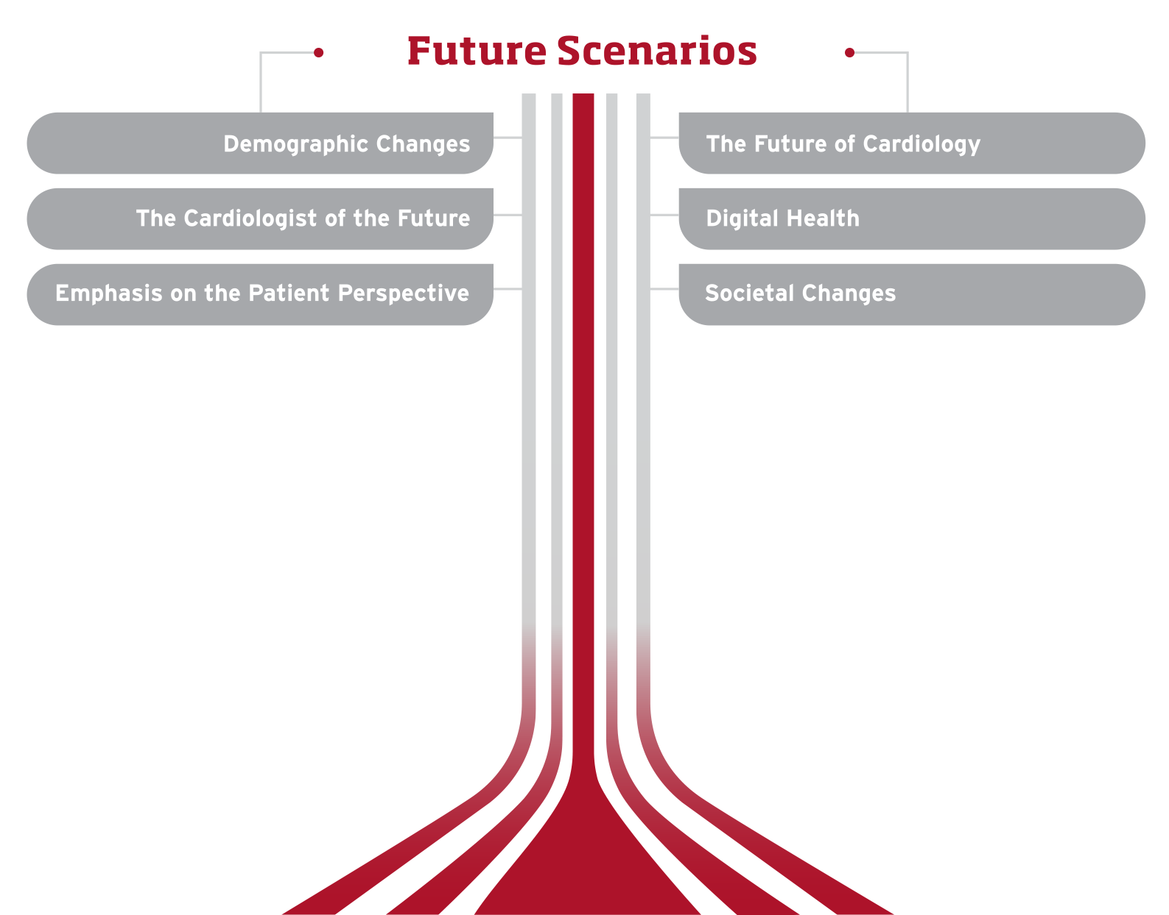
Future Scenarios
A strategic roadmap requires the identification of future developments and trends that will influence the organisation and the environment in which it operates. For the ESC, such trends include those immediately linked to heart disease, cardiovascular science, and the practice of cardiology but also medicine and the provision of healthcare in general, as well as general aspects of life and society.
Based on the identification and ranking of future developments, scenarios were developed that describe their specific influence on our organisation.
These scenarios suggest actions to proactively address difficulties the ESC may face but they also identify opportunities that will enhance
our ability to fulfil our mission.
©2023 European Society of Cardiology. May not be reproduced, displayed, modified or distributed without explicit written permission from ESC.

Slide 6


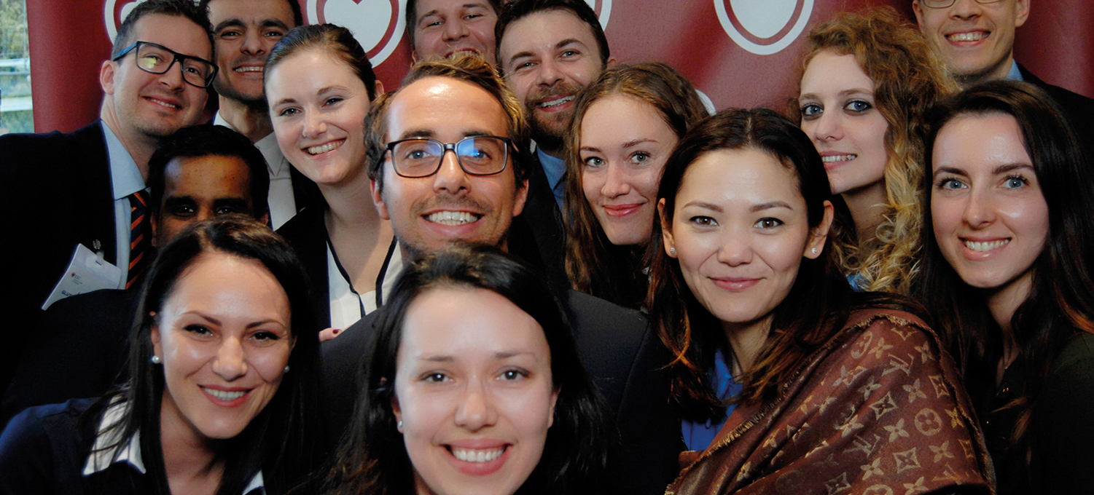
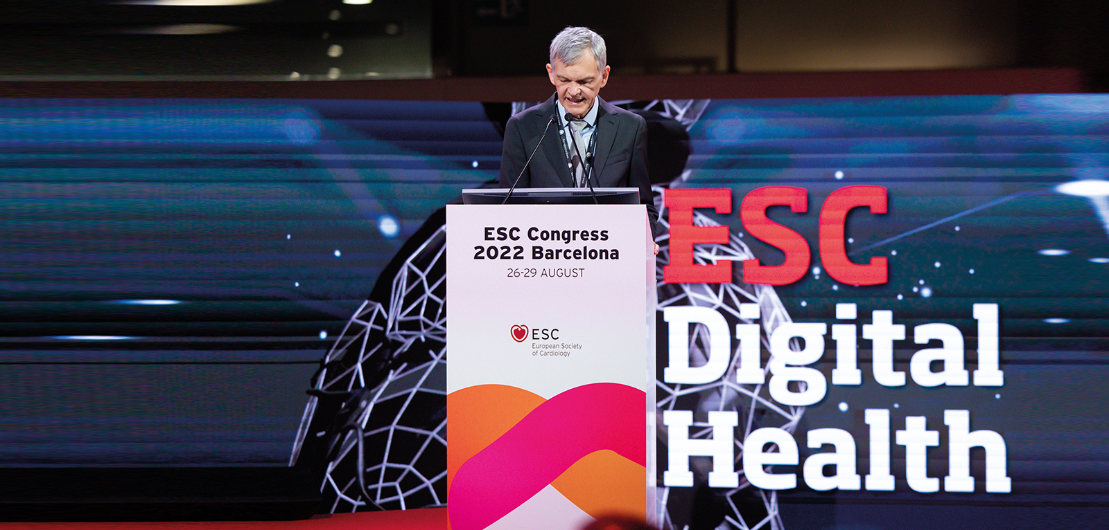
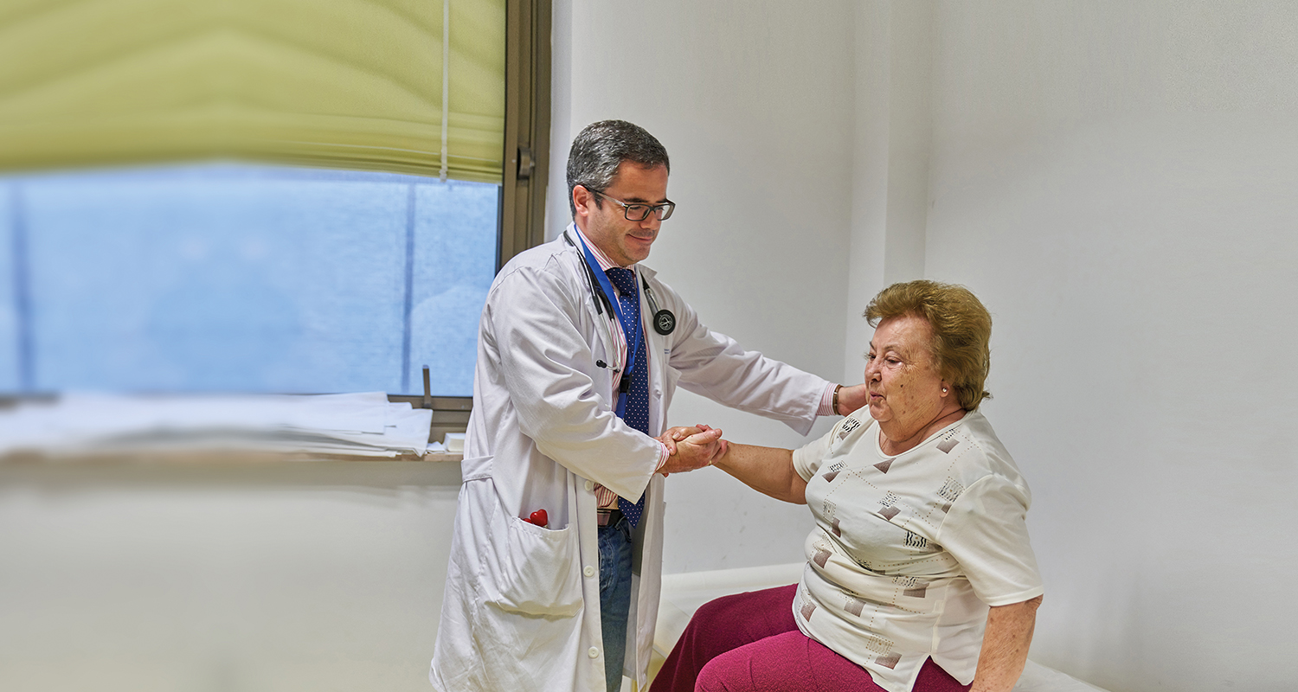

Scenarios
SCENARIO 1
SCENARIO 2
SCENARIO 3
Ageing of the population and increased multimorbidity
Precision medicine through increasingly refined diagnostic and therapeutic options
Subspecialisation shapes the professional landscape in cardiovascular medicine
SCENARIO 4
SCENARIO 5
SCENARIO 6
Digital tools, artificial intelligence and big data analytics play a prominent role in medicine and research
The patient at the heart of all that we do
Evolving priorities and values include climate change and environmental sustainability, diversity and inclusivity, but also ethical conduct and freedom from bias and undue influence
©2023 European Society of Cardiology. May not be reproduced, displayed, modified or distributed without explicit written permission from ESC.

Slide 7
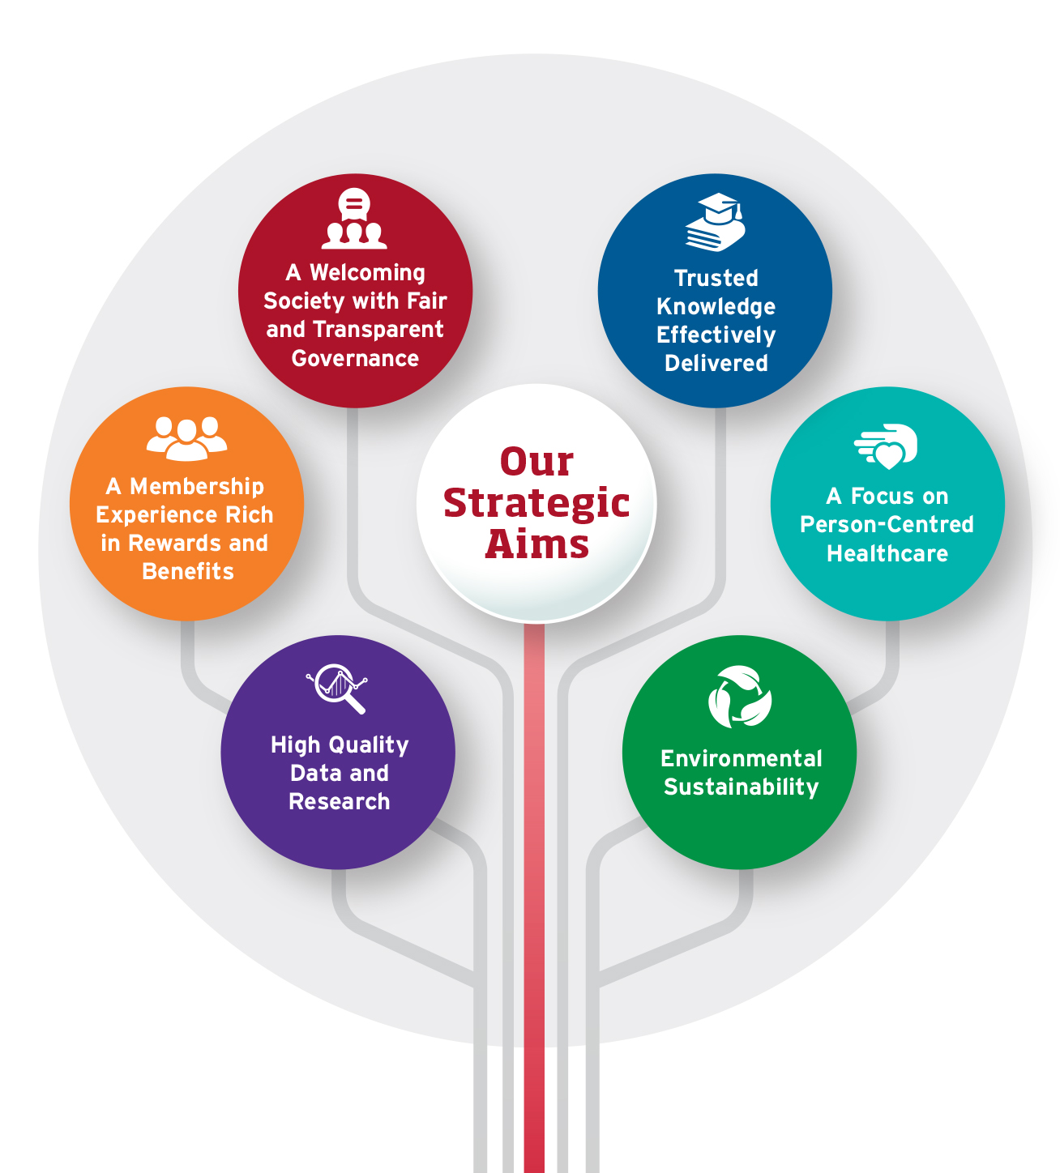
The ESC Strategic Plan 2023-2028
A Welcoming Society with Fair and Transparent Governance: Nurture inclusivity, diversity and clear structures for collective decision-making
Trusted Knowledge Effectively Delivered: Provision of robust and unbiased, validated information in creative formats via communication channels adapted to the needs and preferences of a global audience
A Membership Experience Rich in Rewards and Benefits: Continue to build a strong community with valued year-round membership benefits for cardiovascular healthcare professionals in ESC National Cardiac Societies and across the world
A Focus on Person-Centred Healthcare: Emphasise the patient perspective in research, training and education, as well as guidelines and scientific documents
High Quality Data and Research: Support of collaborative research and active contributions to high quality data collection
Environmental Sustainability: Mindfulness of the environmental footprint and active pursuit of environmental sustainability across all ESC activities
©2023 European Society of Cardiology. May not be reproduced, displayed, modified or distributed without explicit written permission from ESC.

Slide 8
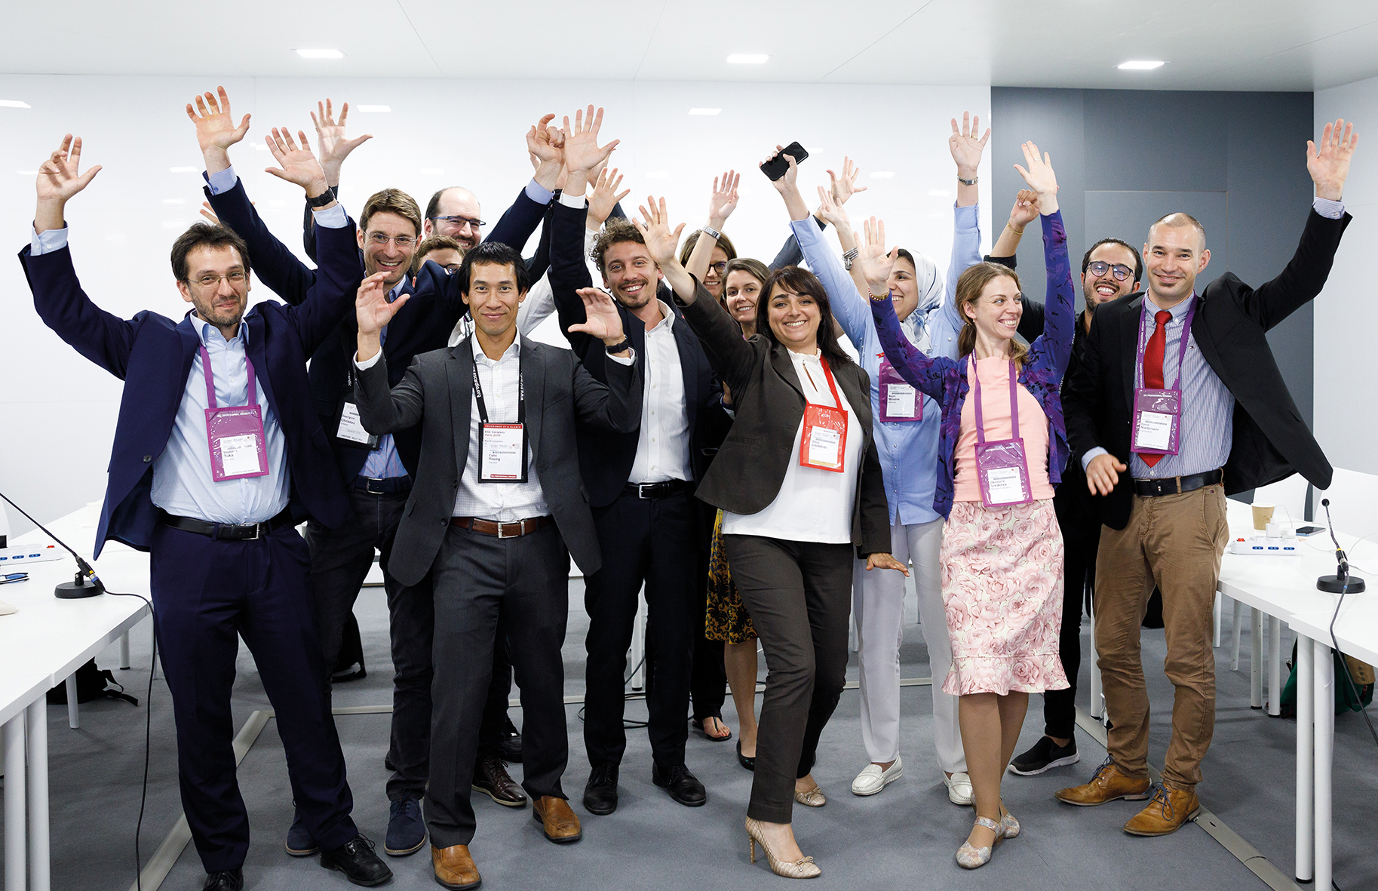
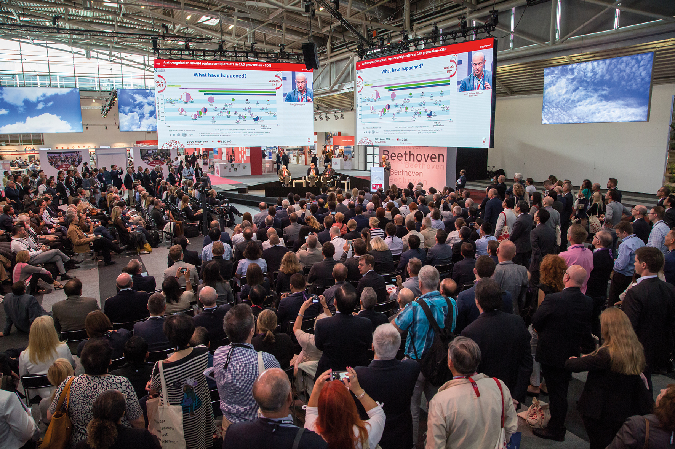
A Welcoming Society with Fair
and Transparent Governance
Trusted Knowledge
Effectively Delivered
Nurture inclusivity, diversity and clear structures for collective decision-making
Provision of robust and unbiased, validated information in creative formats via communication channels adapted to the needs and preferences of a global audience
©2023 European Society of Cardiology. May not be reproduced, displayed, modified or distributed without explicit written permission from ESC.

Slide 9
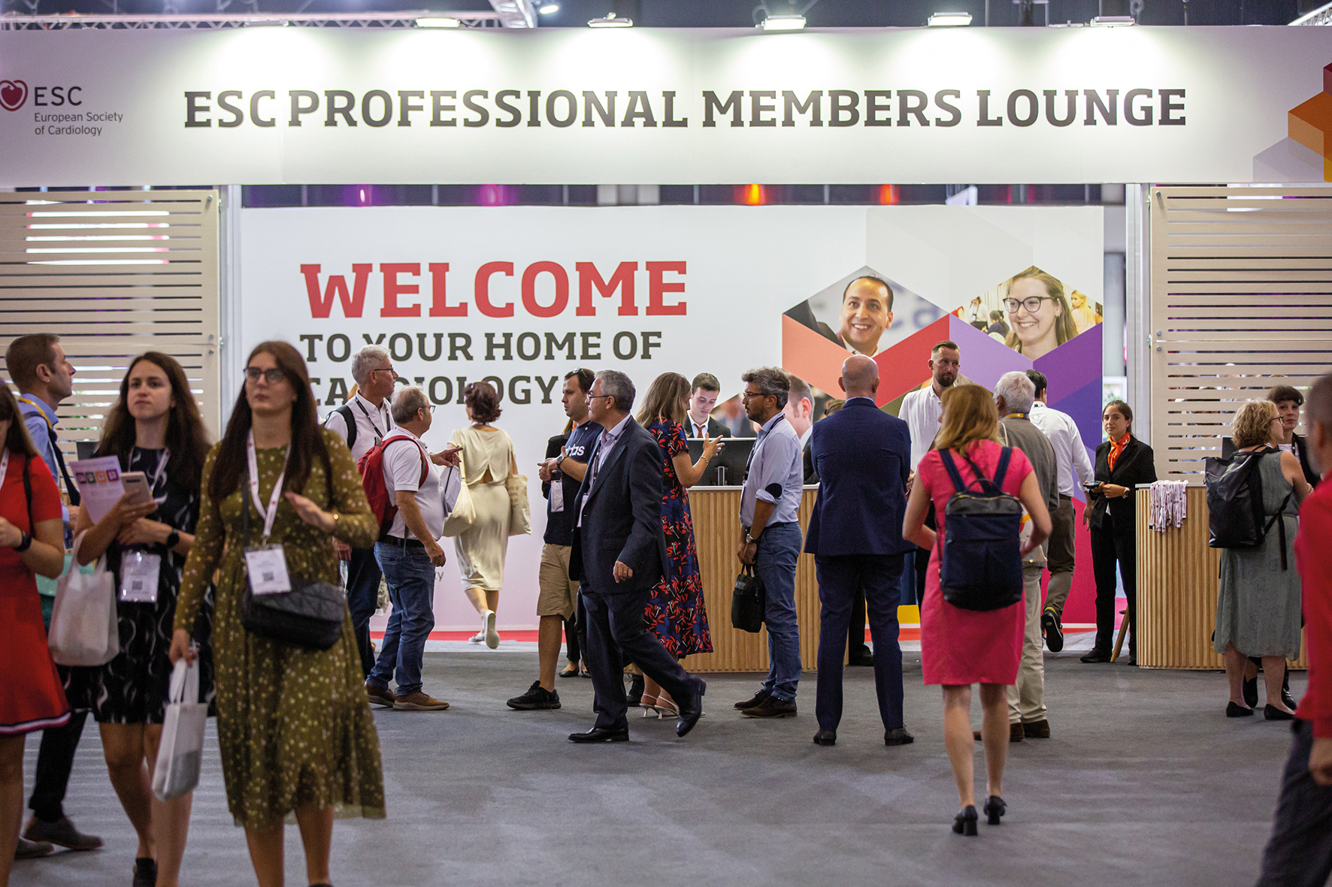

A Membership Experience Rich in Rewards and Benefits
A Focus on Person-Centred Healthcare
Continue to build a strong community with valued year-round membership benefits for cardiovascular healthcare professionals in ESC National Cardiac Societies and across the world
Emphasise the patient perspective in research, training and education, as well
as guidelines and scientific documents
©2023 European Society of Cardiology. May not be reproduced, displayed, modified or distributed without explicit written permission from ESC.

Slide 10
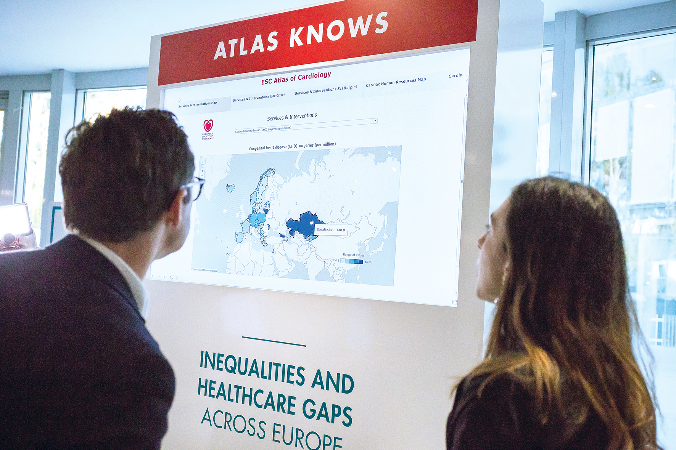
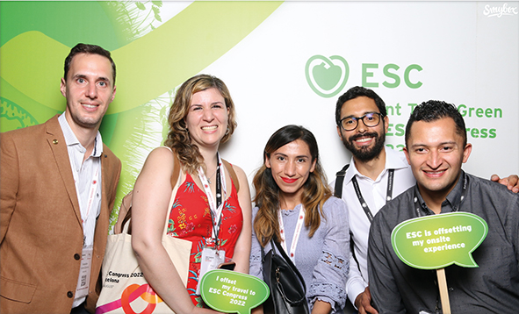
High Quality Data
and Research
Environmental
Sustainability
Support of collaborative research and active contributions to high quality data collection
Mindfulness of the environmental footprint and active pursuit of environmental sustainability across all ESC activities
©2023 European Society of Cardiology. May not be reproduced, displayed, modified or distributed without explicit written permission from ESC.

Slide 11
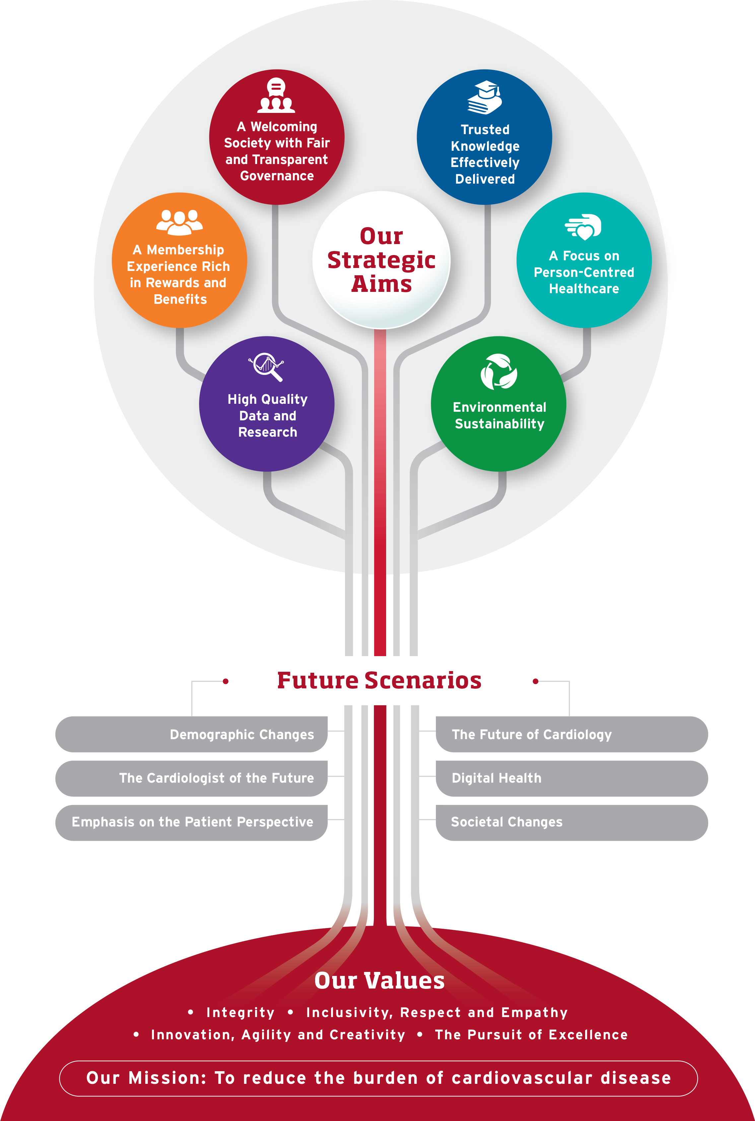
The ESC Strategic Plan 2023 – 2028
A Welcoming Society with Fair and Transparent Governance: Nurture inclusivity, diversity and clear structures for collective decision-making
Trusted Knowledge Effectively Delivered: Provision of robust and unbiased, validated information in creative formats via communication channels adapted to the needs and preferences of a global audience
A Membership Experience Rich in Rewards and Benefits: Continue to build a strong community with valued year-round membership benefits for cardiovascular healthcare professionals in ESC National Cardiac Societies and across the world
A Focus on Person-Centred Healthcare: Emphasise the patient perspective in research, training and education, as well as guidelines and scientific documents
High Quality Data and Research: Support of collaborative research and active contributions to high quality data collection
Environmental Sustainability: Mindfulness of the environmental footprint and active pursuit of environmental sustainability across all ESC activities
Demographic Changes: Ageing of the population and increased multimorbidity
The Future of Cardiology: Precision medicine through increasingly refined diagnostic and therapeutic options
The Cardiologist of the Future: Subspecialisation shapes the professional landscape in cardiovascular medicine
Digital Health: Digital tools, artificial intelligence and big data analytics play a prominent role in medicine and research
Emphasis on the Patient Perspective: The patient at the heart of all that we do
Societal Changes: Evolving priorities and values include climate change and environmental sustainability, diversity and inclusivity, but also ethical conduct and freedom from bias and undue influence
Integrity: Trustworthiness, transparency and adherence to strong principles
Inclusivity, Respect and Empathy: Integration of all stakeholders in cardiovascular medicine, in a community that is open and diverse
Innovation, Agility and Creativity: Inspired adaptation to emerging needs and evolving trends; ready to experiment
The Pursuit of Excellence: Focus on expert performance, our mission, our patients
©2023 European Society of Cardiology. May not be reproduced, displayed, modified or distributed without explicit written permission from ESC.

